Slide 1
Coordinated Investment Portfolio and Reverse Mortgage Withdrawals
Sacks, Barry H., and Stephen R. Sacks. 2012. “Reversing the Conventional Wisdom: Using Home Equity to Supplement Retirement Income.” Journal of Financial Planning 25(2): 43-52.
Sacks, Barry, and Mary Jo Lafaye, Case Study. In Giordano, Shelley. 2016 “An Alternative Asset to Buffer Sequence-of-Return Risk in Retirement.” The Retirement Management Journal, 6(1): 17-26.
(Case study of living on portfolio from 1973 – 2002)

Slide 2
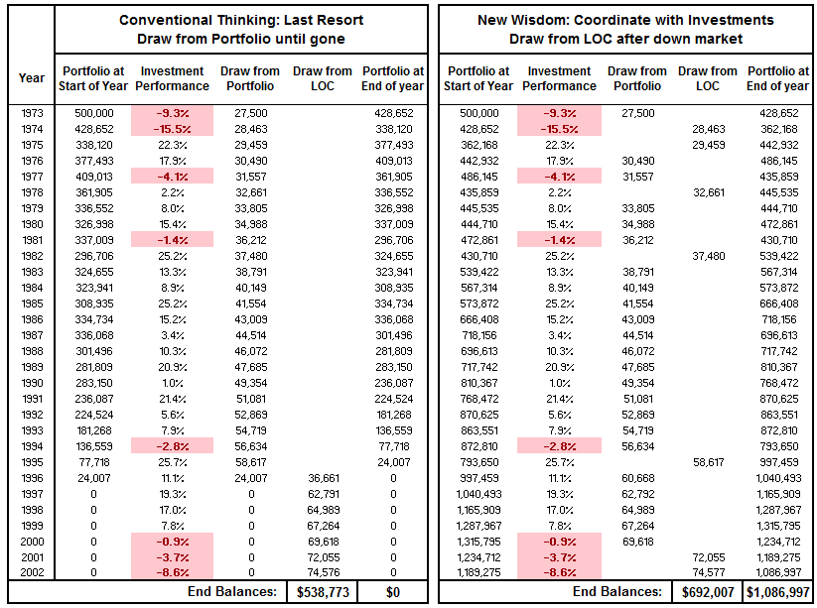

Slide 4
-$538,773 Net
+$394,991 Net
+$933,764 Estate Increase

Slide 5
30-Year $500,000 Portfolio
50/50 equity/bond: 1973 – 2003
No Withdrawals

Slide 6
30-Year $500,000 Portfolio
50/50 equity/bond: 1973 – 2003
No Withdrawals
First decade: weak
  (Arab oil embargo, …)
Middle decade: good
Last decade: great (dot.com boom)

Slide 7
30-Year $500,000 Portfolio
50/50 equity/bond: 1973 – 2003
No Withdrawals
First decade: weak
  (Arab oil embargo, …)
Middle decade: good
Last decade: great (dot.com boom, Y2K)
Weak

Slide 8
30-Year $500,000 Portfolio
50/50 equity/bond: 1973 – 2003
No Withdrawals
Last Resort - ReLOC
Notes:
Decumulation has very different dynamics than accumulation!
The first years have maximum impact
Sequence risk is highest in the first year, next highest in 2nd year, …
The first 5 years sequence risk is the highest of any other years
What do you think the next decade will bring?
High PE Ratios now in equities (Shiller’s CAPE ratio does reasonable job of predicting next decade’s growth rate: expect lower
Very low interest rates now (negative in a variety of important countries). Would expect bond returns to be very low for next 10 years.
10 year LIBOR is under 2: That’s the market’s assessment of compounded return expected over 10 years.
Together, lower returns from portfolios of equities and bonds
But volatility will likely stay at historic levels. No reason to assume smoother sailing!

Slide 9
Coordinate ReLOC and Portfolio
Don’t withdraw from portfolio after a down year
Establish ReLOC at beginning of retirement
Beginning of each year: Set aside this year’s spending
Where to get spending money? Portfolio or Reverse Mortgage?
$ from Portfolio
Up
Down
Portfolio last year
$ from ReLOC
Sacks and Sacks, Journal of Financial Planning, 2012

Slide 10
30-Year $500,000 Portfolio
50/50 equity/bond: 1973 – 2003
No Withdrawals
Coordinated Strategy
Last Resort - ReLOC
Notes:
Decumulation has very different dynamics than accumulation!
The first years have maximum impact
Sequence risk is highest in the first year, next highest in 2nd year, …
The first 5 years sequence risk is the highest of any other years
What do you think the next decade will bring?
High PE Ratios now in equities (Shiller’s CAPE ratio does reasonable job of predicting next decade’s growth rate: expect lower
Very low interest rates now (negative in a variety of important countries). Would expect bond returns to be very low for next 10 years.
10 year LIBOR is under 2: That’s the market’s assessment of compounded return expected over 10 years.
Together, lower returns from portfolios of equities and bonds
But volatility will likely stay at historic levels. No reason to assume smoother sailing!

